Slide 1
Performance Analysis using Sentiment Analyzer
Group Members
N. N. H. Priyanka (15T91A0525)
G.S.S.Gowthami (15T91A0533)
A.Sindhusha (15T91A0521)
Under The Guidance of
Mr Y. Durga Prasad
Asst. Prof.

Slide 2
CONTENTS
Abstract
Existing System
Disadvantages of Existing System
Proposed System
Features of Proposed System
System Modules
UML Diagrams
Implementation
Screenshots
Conclusion
References

Slide 3
ABSTARCT
This project presents a combination of machine learning and natural language processing approaches for sentiment analysis of students feedback.

Slide 4
EXISTING SYSTEM
In the existing system students used to give feedbacks manually on paper feedback forms. It was a time consuming and very inefficient process.
Then the forms are collected and the HOD’s views the feedbacks of students and analyze the performance of that teacher of that particular department.

Slide 5
DISADVANTAGES OF EXISTING SYSTEM
It is time consuming job.
It is difficult to maintain the feedback details.
Preparation of reports is not an easy work.
sometimes information may be lost or overloaded by human.

Slide 6
PROPOSED SYSTEM
Then to overcome the limitations of that system came the online feedback systems which takes the feedback of students online and automatically analyzes the feedback to analyze the performance of teachers.
Sentiment classification identifies sentiment polarity (positive or negative) from text (sentence or document), has been the most extensively studied task in sentiment analysis.
This system is a secured system.
The identity of the students giving feedback is not disclosed to anyone not even the admin.
A single student can give only a single feedback to a particular teacher.

Slide 7
FEATURES OF PROPOSED SYSTEM
Giving feedback online saves time in comparison to manual process.
Teacher’s performance can be increased using the analyzed feedback.
Descriptive type questions can be analyzed by using the sentiment analyzer which was not possible in previous online feedback analysis system.
The identity of the student is kept anonymous.

Slide 8
SYSTEM MODULES
Admin Module
Student Module
Faculty Module

Slide 9
ADMIN
Admin’s username and password is stored in database.
The username and password of admin are checked with data present in the database.
After login Admin creates the students as well as teachers account and fill their details.
The whole data is stored in the database then. The admin also adds the subjects in the database.

Slide 10
FUNCTIONALITIES OF ADMIN
Admin Login
Admin can add new faculty
Admin can view faculty list
Admin can add new student
Admin can view student list
Admin can assign subject to the faculty.
Admin can check feedback given by the student

Slide 11
STUDENT
Each and every valid student has their unique username and password which is given by admin.
The username and password when entered are checked with data present in the database.
After login student, in the feedback form the name of the teacher and the subject will automatically appears in the screen.
After the submission of feedback the answers of all the questions are analyzed and the result is stored in database

Slide 12
FUNCTIONALITIES OF STUDENT
Student can login
Student can view feedback status
Student can give feedback
Logout

Slide 13
FACULTY
Each and every teacher has their unique username and password which is given by the admin.
The username and password when entered are checked with data present in the database.
The teachers can view their individual overall performance according to the student’s feedback.
And student’s identity is not revealed to the teacher.

Slide 14
FUNCTIONALITIES OF FACULTY
Faculty can login
Faculty can check individual feedback given by the students
Logout

Slide 15
UML DIAGRAMS
Dataflow Diagram
Use Case Diagram
Sequence Diagram
Activity Diagram

Slide 16
DATA FLOW DIAGRAM
The DFD is also called as bubble chart.
It is a simple graphical formalism that can be used to represent a system in terms of input data to the system, various processing carried out on this data, and the output data is generated by this system.

Slide 17
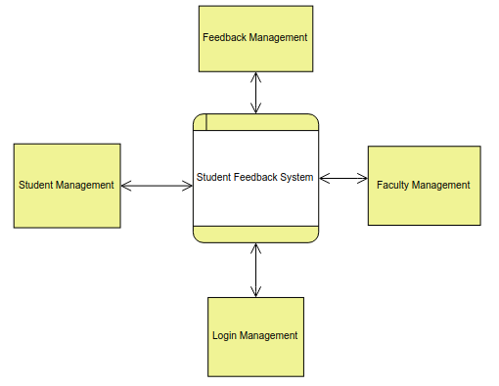
DATA FLOW DIAGRAM
Data Flow Diagram Level 0

Slide 18
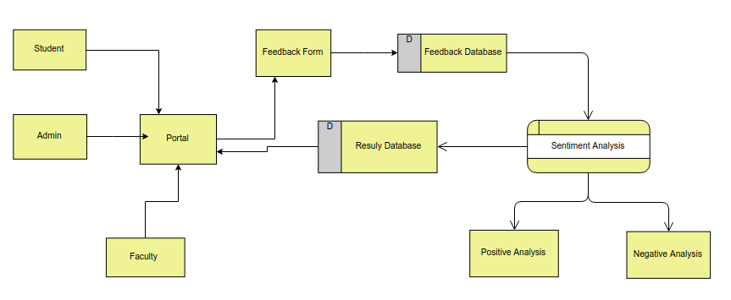
DATA FLOW DIAGRAM
Data Flow Diagram Level 1

Slide 19
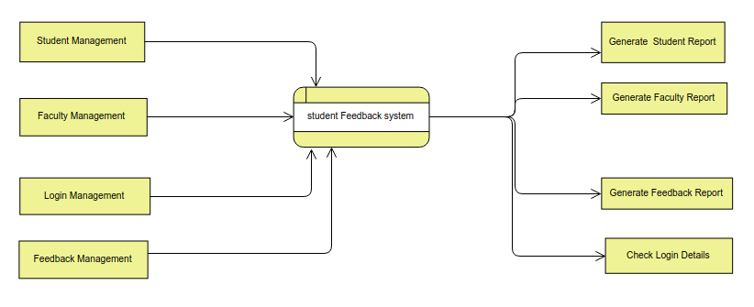
DATA FLOW DIAGRAM
Data Flow Diagram Level 2

Slide 20
USE CASE DIAGRAM
A use case is a set of scenarios that describing an interaction between a user and a system.
A use case diagram displays the relationship among actors and use cases.
The two main components of a use case diagram are use cases and actors.

Slide 21
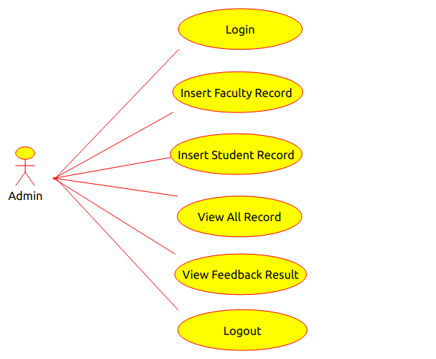
USE CASE DIAGRAM FOR ADMIN

Slide 22
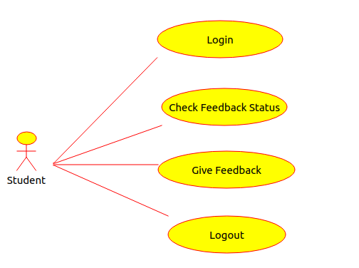
USE CASE DIAGRAM FOR STUDENT

Slide 23
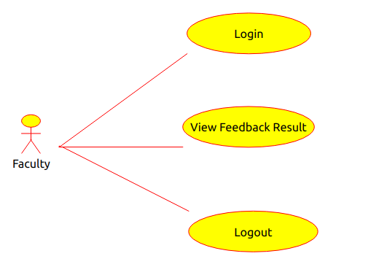
USE CASE DIAGRAM FOR FACULTY

Slide 24
SEQUENCE DIAGRAM
A sequence diagram shows object interactions arranged in time sequence.
It depicts the objects and classes involved in the scenario and the sequence of messages exchanged between the objects needed to carry out the functionality of the scenario.

Slide 25
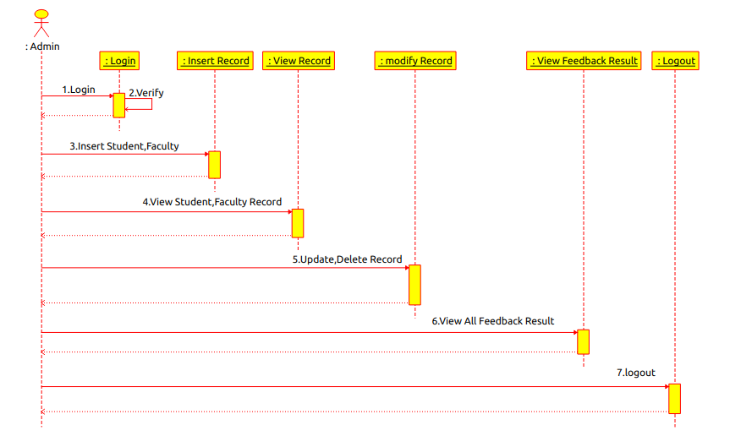
SEQUENCE DIAGRAM FOR ADMIN

Slide 26
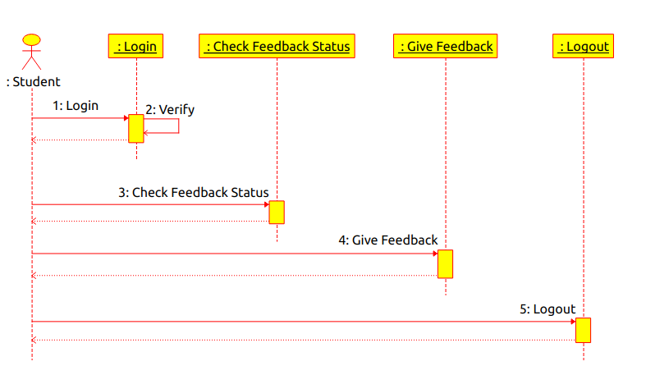
SEQUENCE DIAGRAM FOR STUDENT

Slide 27
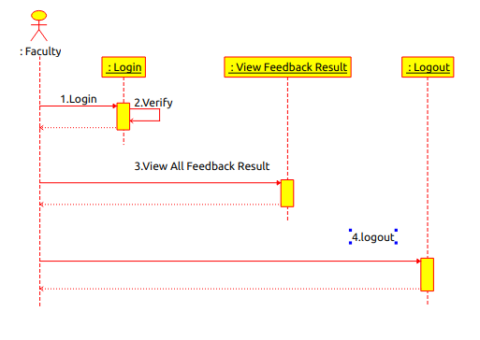
SEQUENCE DIAGRAM FOR FACULTY

Slide 28
ACTIVITY DIAGRAM
Activity diagrams describe the workflow behavior of a system.
The diagrams describe the state of activities by showing the sequence of activities performed.

Slide 29
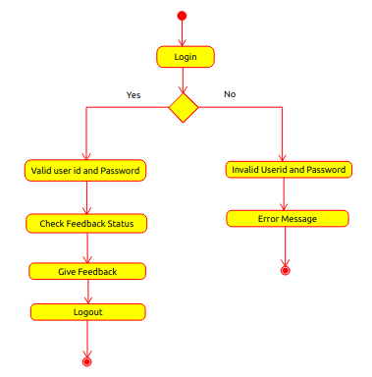
ACTIVITY DIAGRAM FOR STUDENT

Slide 30
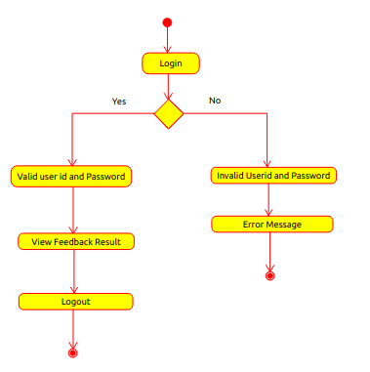
ACTIVITY DIAGRAM FOR FACULTY

Slide 31
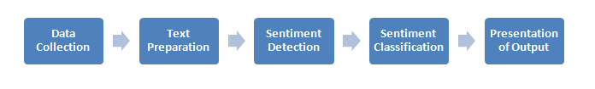
IMPLEMENTATION
Sentiment Analysis
The sentiment analyzer is build using machine learning algorithms
The algorithm is trained using the training data set which contains positive and negative words. And then the model is created using the trained algorithm.
Firstly, we are using the General Sentiment Analysis Algorithm which is tuned to analyse the sentiment of a general statement/review
This General Sentiment Analysis Algorithm accepts any particular string and in return gives an emotion with the help of a rating for positive, negative and neutral. Then we have a compound result which provides the complete rating of the string.
Sentiment Analysis Process

Slide 32
EXAMPLE
Input Example:
{
“sentenceList“:[
“I like computer programming “,
“I love data mining and sentiment analysis”,
]
}
Output Example:
[
{
“positive “: 0.455,
“negative” :0,
“sentence”: I like computer programming “,
“neutral”:0.545,
},
{
“positive “: 0.673,
“negative “: 0,
“sentence”: I love data mining and sentiment analysis”,
“neutral”:0.488,
},

Slide 33
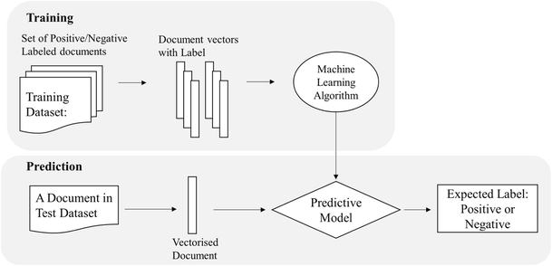
NAVIE BAYE’S CLASSIFIER
A Naive Bayes classifier is a probabilistic machine learning model that is used for classification of text.
The Naive Bayesian classifier is based on Bayes’ theorem with the independent assumptions between predictors.
Naive Baye’s flowchart

Slide 34
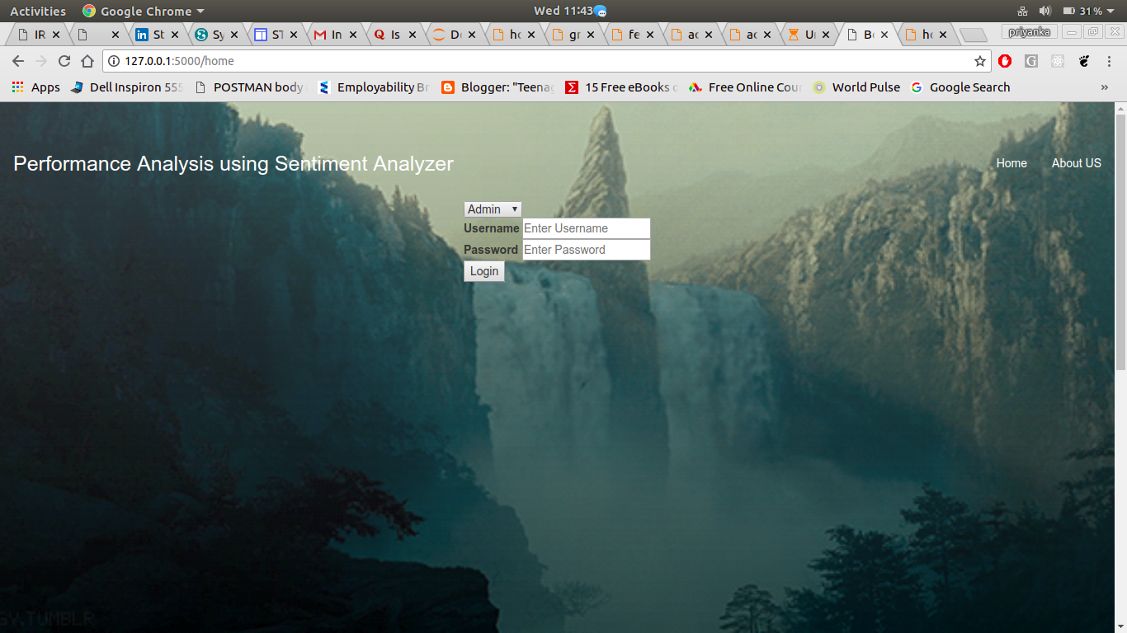
HOME PAGE
Home Page Screen 1

Slide 35
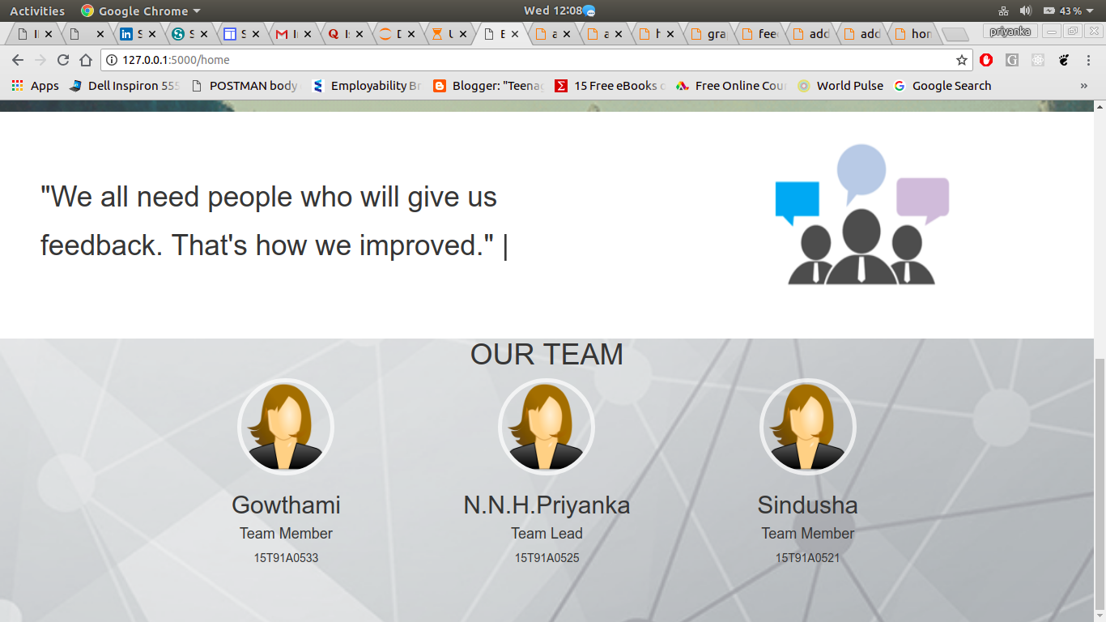
Home Page Screen 2

Slide 36
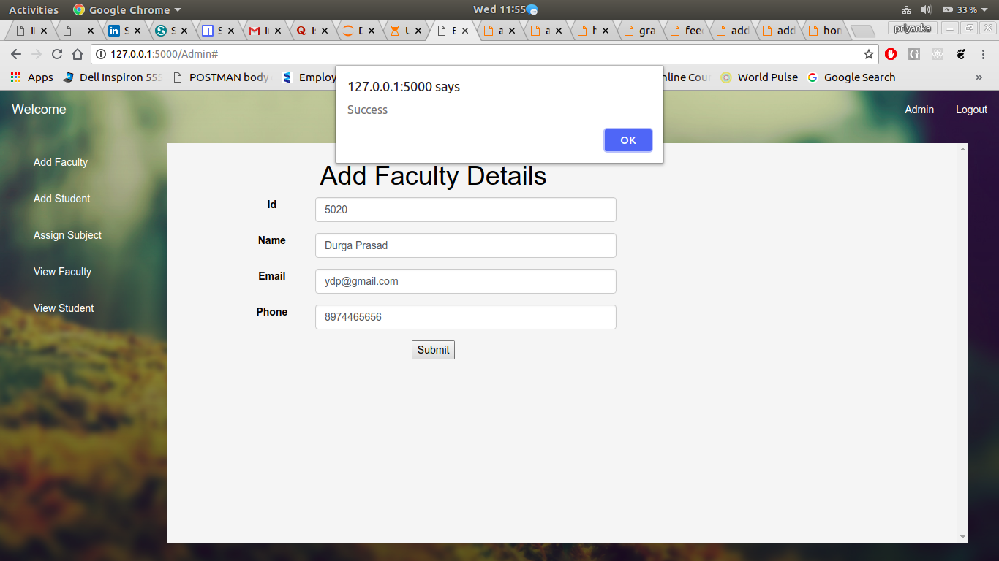
ADMIN
Add Faculty Page

Slide 37
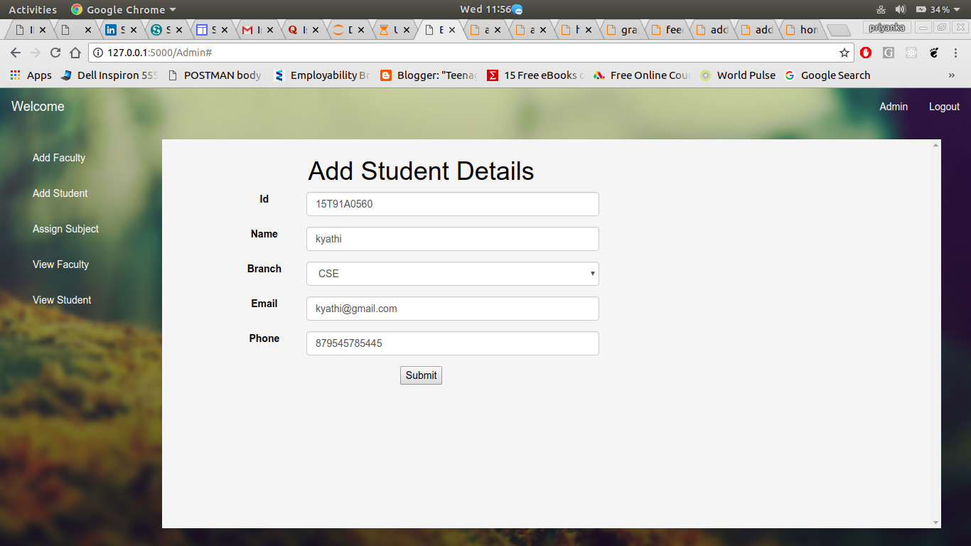
ADMIN
Add Student Page

Slide 38
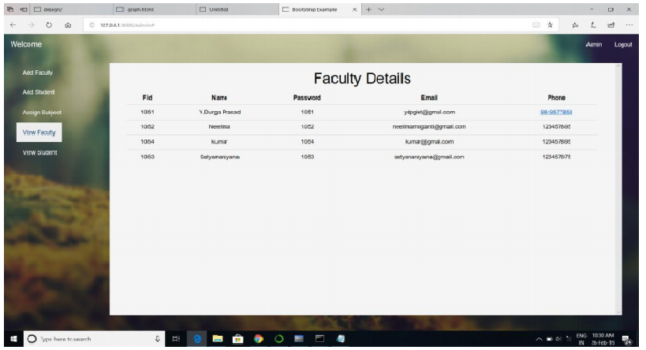
ADMIN
View Faculty Page

Slide 39
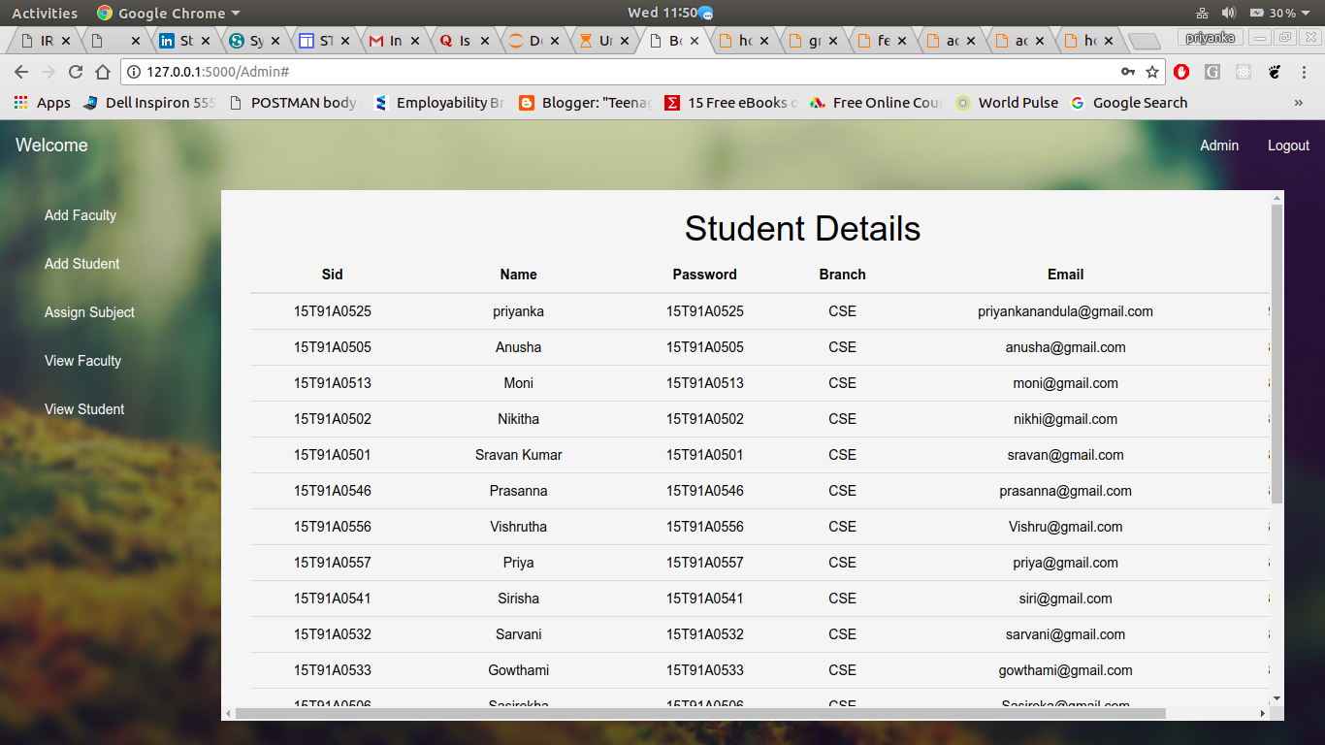
ADMIN
View Student Page

Slide 40
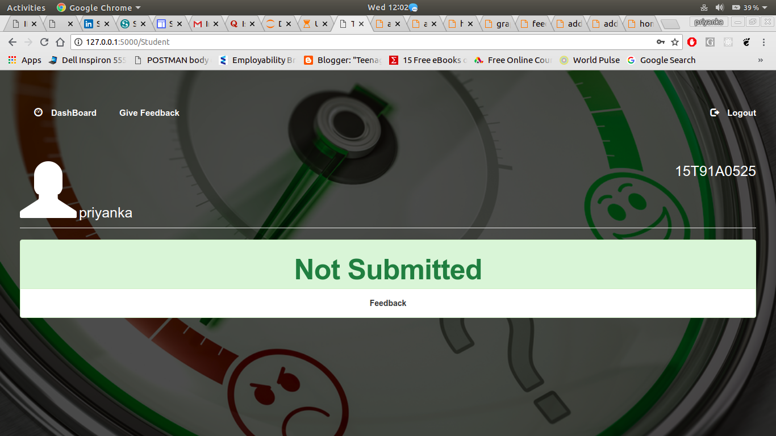
STUDENT
Dashboard page

Slide 41
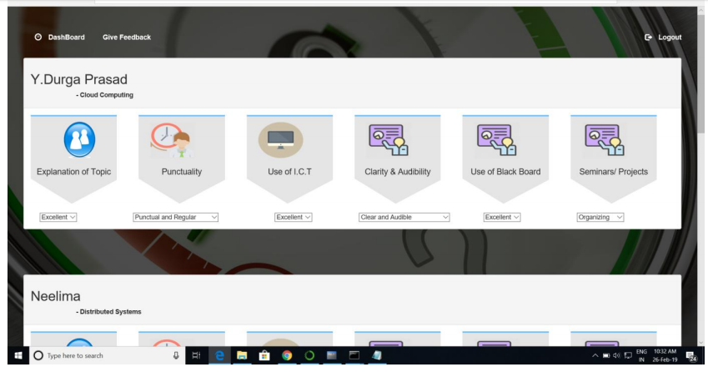
STUDENT
Give Feedback page

Slide 42
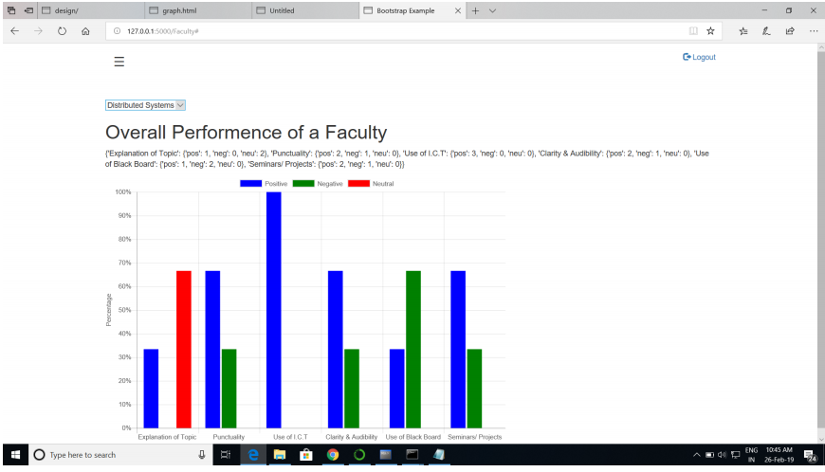
FACULTY
View Feedback page

Slide 43
CONCLUSION
In this project a sentiment analyzer is implemented to analyze the student’s feedback so to increase the accuracy of the system. Sentiment analysis tools can identify and analyse the text automatically and quickly.

Slide 44
REFERENCES
Alok Kumar,Renu Jain in Sentiment analysis and Feedback Evaluation
Agarwal, A., Xie, B., Vovsha, I., Rambow, O., Passonneau, R.: Sentiment analysis of twitter data. In: Proceedings of the Workshop on Languages in Social Media. pp. 30–38. Association for Computational Linguistics, Stroudsburg, PA, USA (2011)
Gamon, M.: Sentiment classification on customer feedback data: Noisy data, large feature vectors, and the role of linguistic analysis. In: International Conference on Computational Linguistics, vol. 20, pp. 841–847 (2004)Google Scholar

Slide 45
THANK YOU

